Slide 1
Immunology
By
Dr. Nelson Xess
Department of Microbiology
Bhanupratap Deo Govt. P.G College, Kanker, Chhattisgarh

Slide 2
Strength of Antigen- Antibody Interactions
The noncovalent interactions that form the basis of antigenantibody (Ag-Ab) binding include hydrogen bonds, ionic bonds, hydrophobic interactions, and van der Waals interactions.
The interaction between an antibody and an antigen depends on four types of noncovalent forces:
(1) hydrogen bonds, in which a hydrogen atom is shared between two electronegative atoms;
(2) ionic bonds between oppositely charged residues.
(3) hydrophobic interactions, in which water forces hydrophobic groups together.
(4) vander Waals interactions between the outer electron clouds of two or more atoms. In an aqueous environment, noncovalent interactions are extremely weak and depend upon close complementarity of the shapes of antibody and antigen.

Slide 3
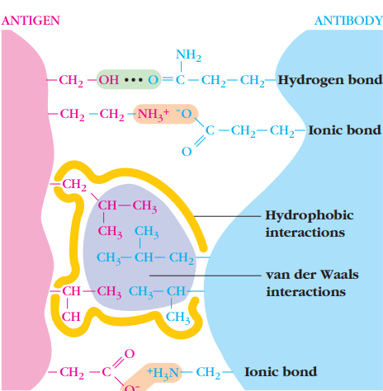
Strength of Antigen- Antibody Interactions

Slide 4
Precipitation Reactions
Antibody and soluble antigen interacting in aqueous solution form a lattice that eventually develops into a visible precipitate. Antibodies that aggregate soluble antigens are called precipitins. Although formation of the soluble Ag-Ab complex occurs within minutes, formation of the visible precipitate occurs more slowly and often takes a day or two to reach completion.
Formation of an Ag-Ab lattice depends on the valency of both the antibody and antigen:
The antibody must be bivalent; a precipitate will not form with monovalent Fab fragments.
The antigen must be either bivalent or polyvalent; that is, it must have at least two copies of the same epitope, or have different epitopes that react with different antibodies present in polyclonal antisera.

Slide 5
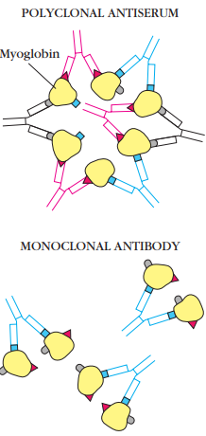
Precipitation Reactions – Polyclonal and Monoclonal Antybody
Polyclonal antibodies can form lattices, or large aggregates, that precipitate out of solution. However, if each antigen molecule contains only a single epitope recognized by a given monoclonal antibody, the antibody can link only two molecules of antigen and no precipitate is formed.

Slide 6
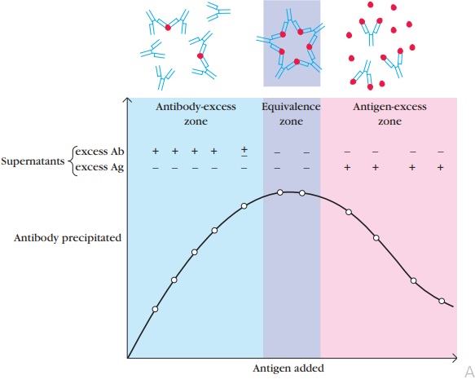
Precipitation reactions
A precipitation curve for a system of one antigen and its antibodies. This plot of the amount of antibody precipitated versus increasing antigen concentrations (at constant total antibody) reveals three zones: a zone of antibody excess, in which precipitation is inhibited and antibody not bound to antigen can be detected in the supernatant; an equivalence zone of maximal precipitation in which antibody and antigen form large insoluble complexes and neither antibody nor antigen can be detected in the supernatant; and a zone of antigen excess in which precipitation is inhibited and antigen not bound to antibody can be detected in the supernatant.

Slide 7
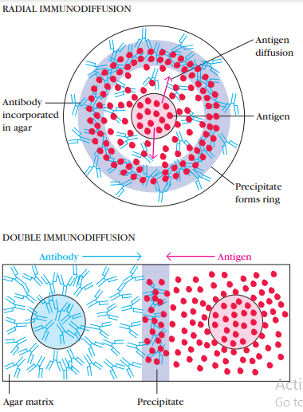
RADIAL IMMUNODIFFUSION & DOUBLE IMMUNODIFFUSION
Diagrammatic representation of radial immunodiffusion (Mancini method) and double immunodiffusion (Ouchterlony method) in a gel. In both cases, large insoluble complexes form in the agar in the zone of equivalence, visible as lines of precipitation (purple regions). Only the antigen (red) diffuses in radial immunodiffusion, whereas both the antibody (blue) and antigen (red) diffuse in double immunodiffusion.

Slide 8
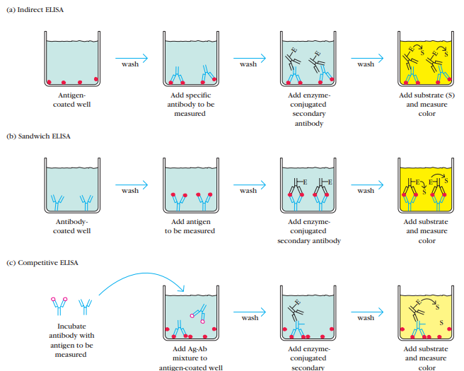

Slide 9
Antigen- Antibody Interaction
The antigen- antibody interaction is similar to association to enzyme-substrate interaction, with an important distinction: it does not lead to an irreversible chemical alteration in either the antibody or the antigen.
The association between an antibody and an antigen involves various noncovalent interactions between the antigenic determinant, or epitope, of the antigen and the variable-region (VH/VL) domain of the antibody molecule, particularly the hypervariable regions, or complementarity-determining regions paratope.

